Slide 1
Benefits Apply Tool
github.com/abitabir/BenefitsApplyTool

Slide 2
Overview
Objective: To design a Participant Data Storage model following OOP principles
Three-layer architecture (Presentation Layer, Business Layer, Data Layer)
Focus on Business Layer using Java
Key Goals:
Data Validation
Evidence Tracking
Flexibility for future updates

Slide 3
Design Approach
UML modelling to reduce the amount of costly changes later on in the software development life cycle
Applied Modern OOP Principles: Encapsulation (private fields with public getters/setters) Inheritance (Evidence superclass) Polymorphism (reusing Evidence for different types) Composition (Participant contains multiple Evidence objects)
Clean separation of concerns – each class handles one responsibility
Follows SOLID principles:
Single Responsibility – Each class focuses on one task
Open/Closed Principle – Easy to extend without modifying existing code
Liskov Substitution – Evidence subclasses are interchangeable

Slide 4
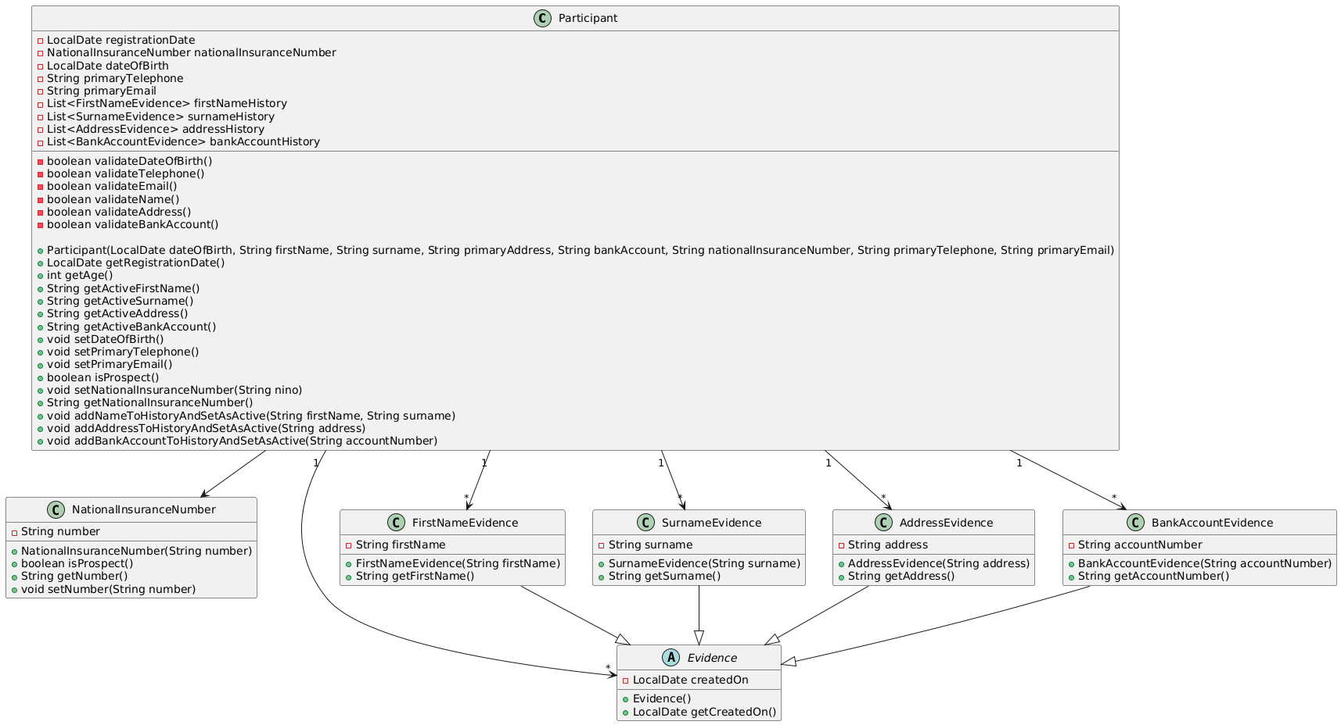
Class Diagram

Slide 5
Class Diagram

Slide 6
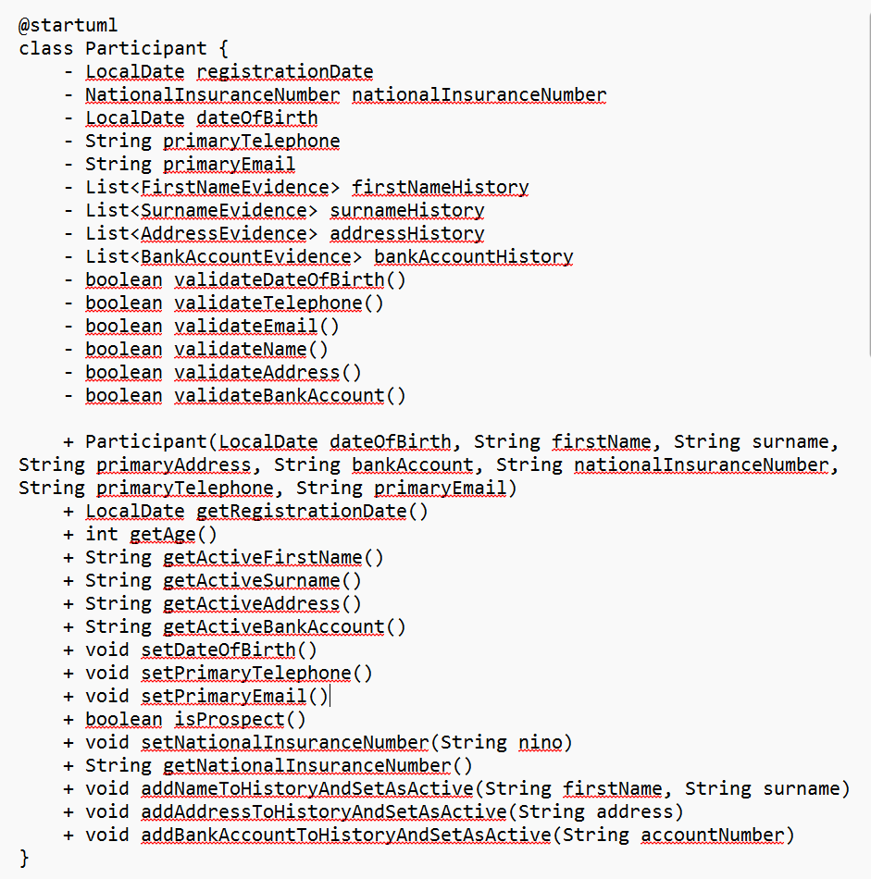
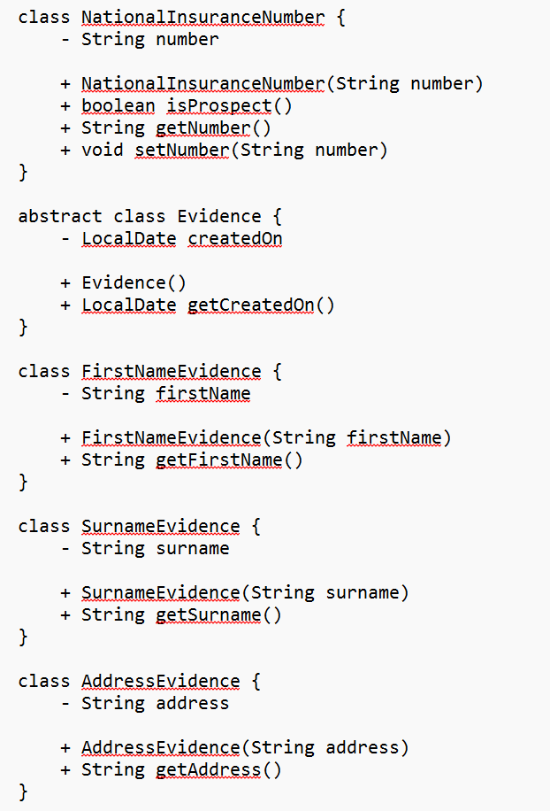
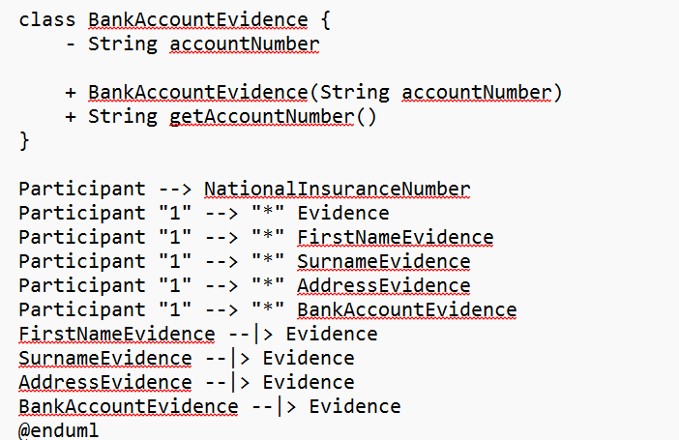

Slide 7
Participant – Core entity holding key details
Evidence – Abstract class for tracking historical data
FirstNameEvidence, SurnameEvidence, AddressEvidence, BankAccountEvidence – Concrete classes extending Evidence
NationalInsuranceNumber – Separate class to handle NINO and prospect status
Explain relationships:
One-to-many from Participant → Evidence
Inheritance for evidence handling

Slide 8
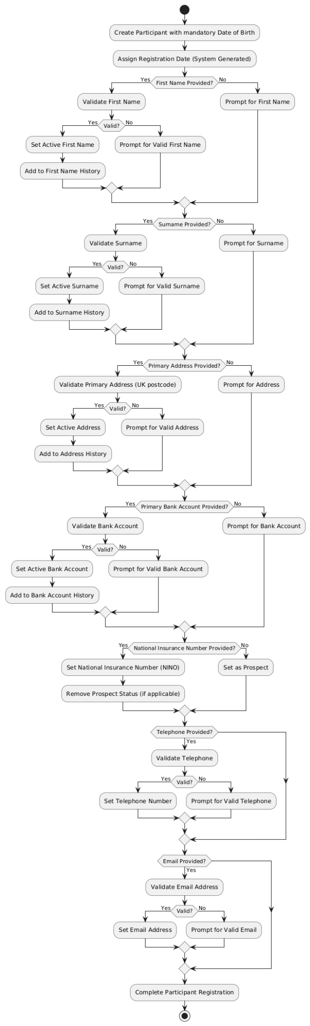
Activity Diagram

Slide 9
Activity Diagram

Slide 10
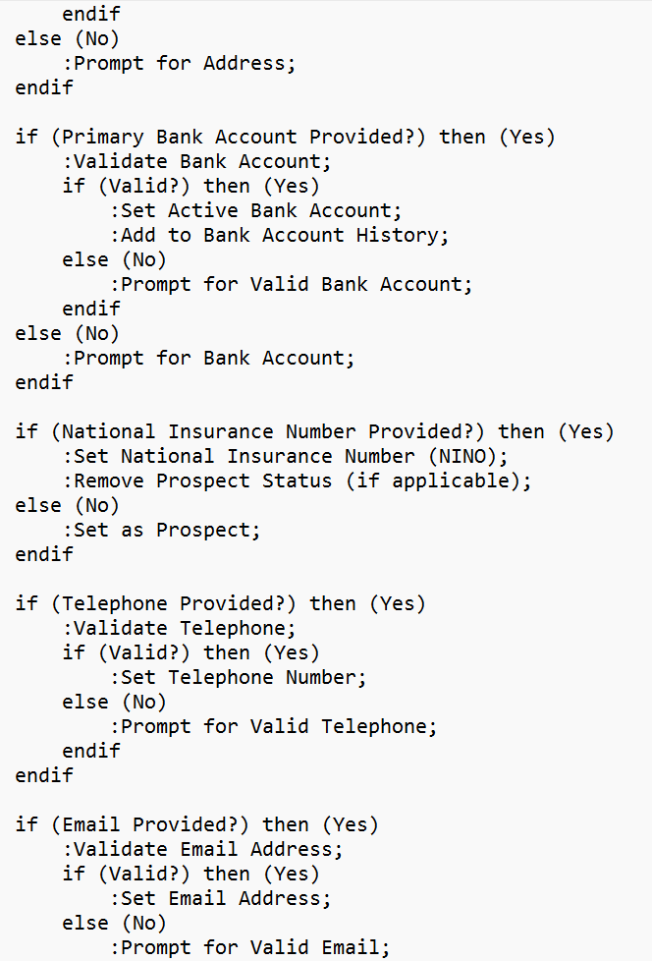
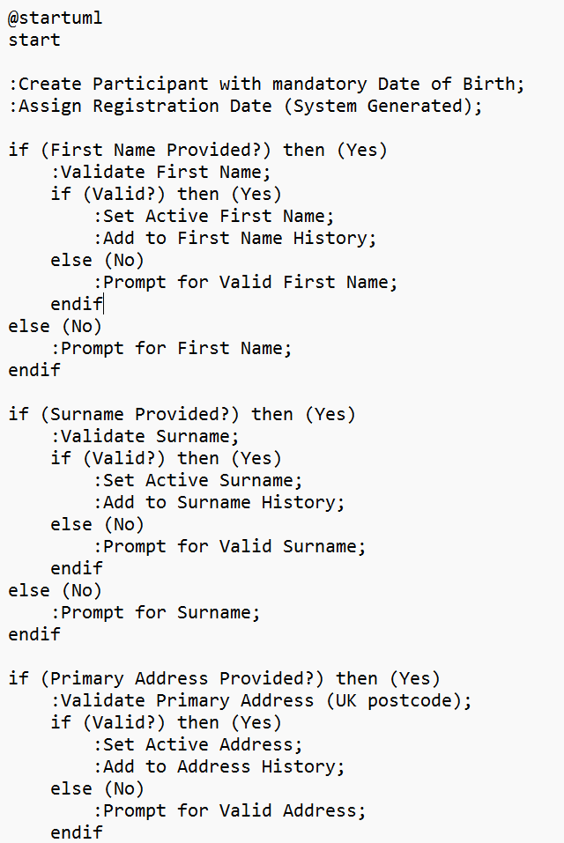
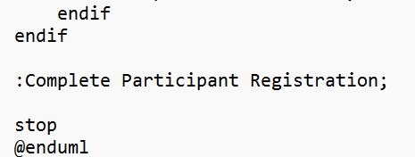

Slide 11
Activity Diagram
Step-by-step creation of a Participant
Data validation at each step
Handling of optional and mandatory fields
Preservation of historical data using Evidence pattern

Slide 12
Acceptance Criteria
Requirement How It’s Addressed
Registration Date Auto-generated and read-only attribute
National Insurance Number Optional, sets "Prospect" status if absent
Date of Birth Mandatory with validation
First Name & Surname Stored as Evidence, only one active value allowed
Primary Address UK postcode format validation, stored as Evidence
Primary Bank Account Stored as Evidence, only one active value allowed
Telephone & Email Validation for format and uniqueness
History Tracking Evidence maintains historical data without overwriting

Slide 13
Key Functionality
Add/Set Operations
addFirstNameToHistoryAndSetAsActive – Adds to history and sets as active
addSurnameToHistoryAndSetAsActive – Same for surname
addAddressToHistoryAndSetAsActive – Same for address
addBankAccountToHistoryAndSetAsActive – Same for bank account
Prospect Handling
Prospect set if no NINO, removed when NINO added
Validation
Custom validators for format and uniqueness

Slide 14
Testing Approach
Unit Testing Strategy: Individual test cases for each method Edge cases tested (e.g., invalid email format) Ensured no overwriting of historical data
Sample Tests
Test setting and retrieving first name
Test adding evidence and tracking history
Test NINO-based prospect status handling
Test Coverage Constructor Tests Getter/Setter Tests Business Logic Tests Edge Cases (Invalid Inputs)

Slide 15
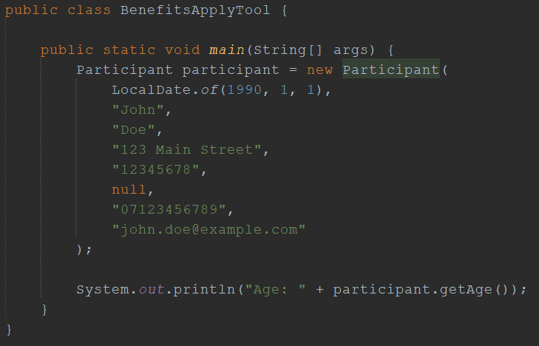
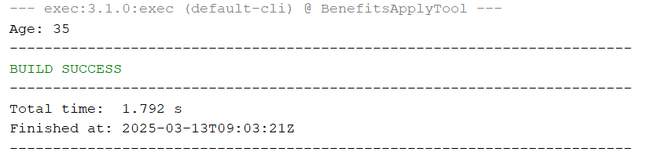
Test Case Example

Slide 16
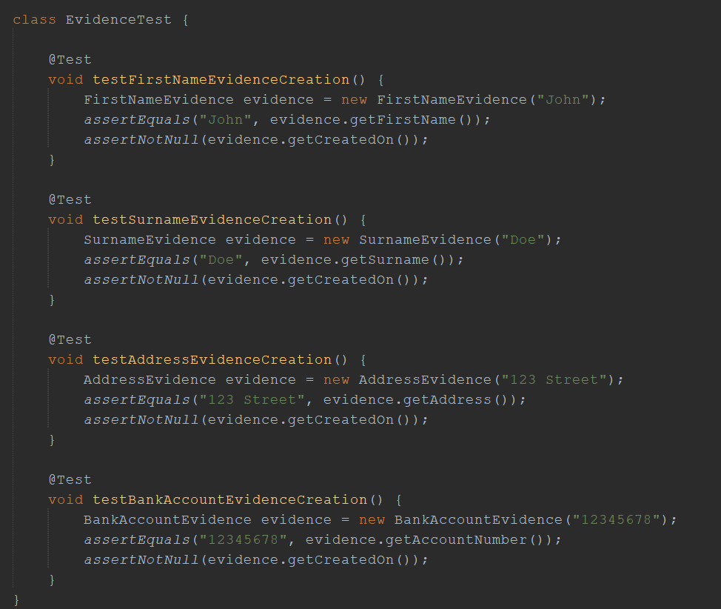
Evidence JUnit Test

Slide 17
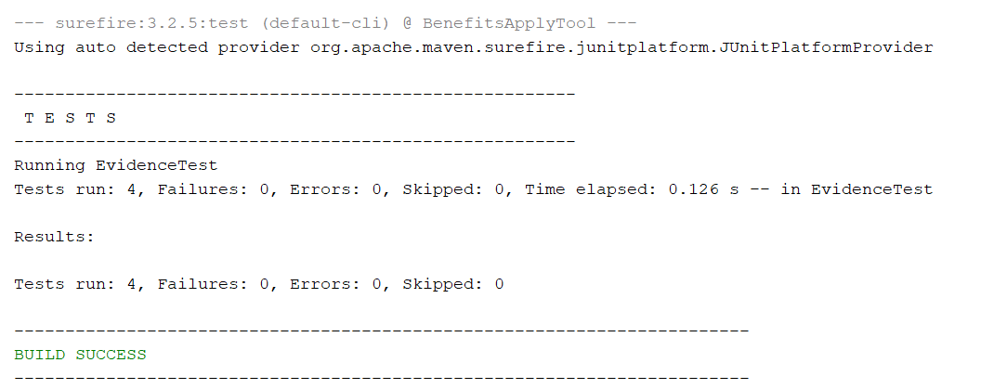
JUnit Tests

Slide 18
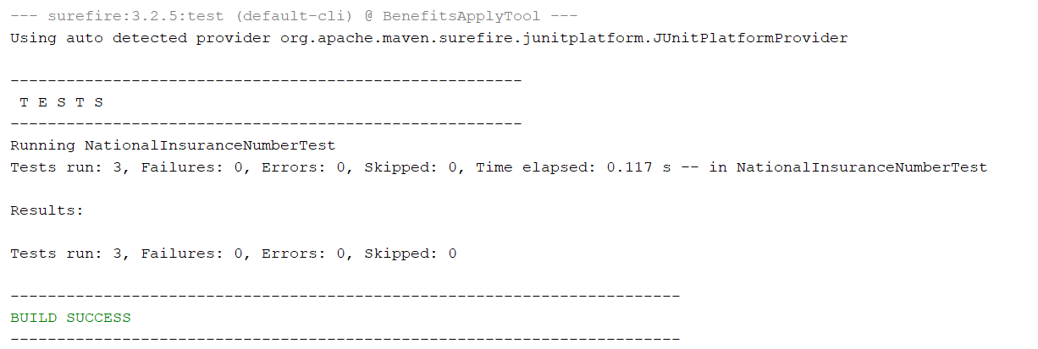
JUnit Tests

Slide 19
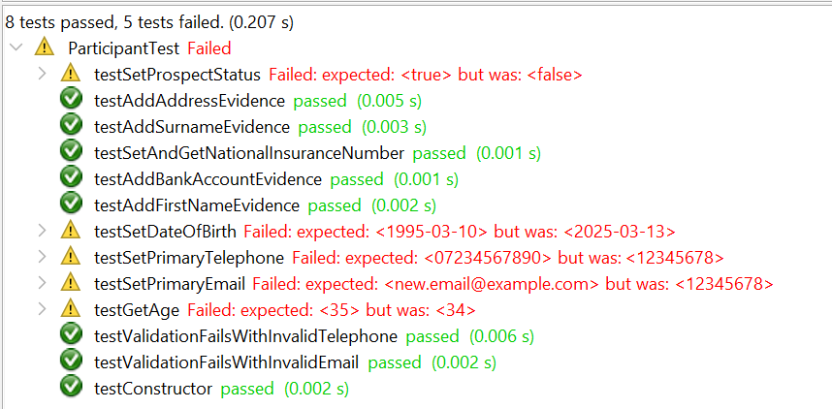
JUnit Tests

Slide 20
Challenges
Getting all tests to pass
Fixing bugs

Slide 21
Q&A
Thank you for listening!

